Slide 1
北京大学微处理器研发中心
硕士工作汇报
BOOM Core
姓名 | 阳庆红 陈东维
学号 | 1501214366
年级 | 2015级

Slide 2
主要内容
Introduction & Overview
Instruction Fetch
Unified Physical Register File
The Decode Stage
The Rename Stage
ROB & The Dispatch Stage
The Issue Unit
The Register File and Bypass
The Execute Pipeline
The Load/Store Unit
后期工作安排

Slide 3
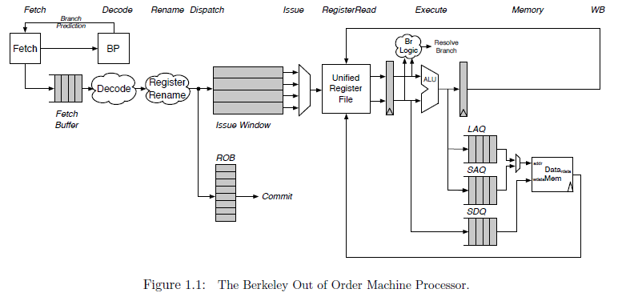
Introduction & Overview
A unified physical register file design
Superscalar、Out of Order、Six stages
Fetch, Decode/Rename/Dispatch, Issue/RegisterRead, Execute, Memory, and Writeback
Notes:
1. Commit occurs asynchronously
2.

Slide 4
主要内容
Introduction & Overview
Instruction Fetch
Unified Physical Register File
The Decode Stage
The Rename Stage
ROB & The Dispatch Stage
The Issue Unit
The Register File and Bypass
The Execute Pipeline
The Load/Store Unit
后期工作安排

Slide 5
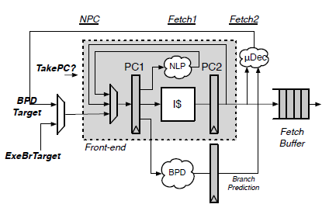
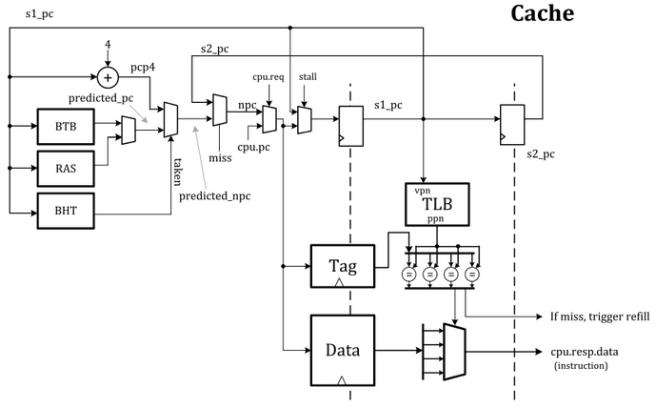
Instruction Fetch
Rocket Core’ Front-end
BOOM Fetch Unit
BOOM instantiates the Rocket core's Front-end
If a misprediction is detected, or BOOM's own predictor wants to redirect the pipeline in a difference direction, a request is sent to the Front-End and it begins fetching along a new instruction path

Slide 6
Instruction Fetch
Rocket Core’ Front-end
BOOM Fetch Unit
Since superscalar fetch is supported, the Front-end returns a fetch packet of instructions
The I-Cache is a virtually indexed, physically tagged set-associative cache

Slide 7
主要内容
Introduction & Overview
Instruction Fetch
Unified Physical Register File
The Decode Stage
The Rename Stage
ROB & The Dispatch Stage
The Issue Unit
The Register File and Bypass
The Execute Pipeline
The Load/Store Unit
后期工作安排

Slide 8
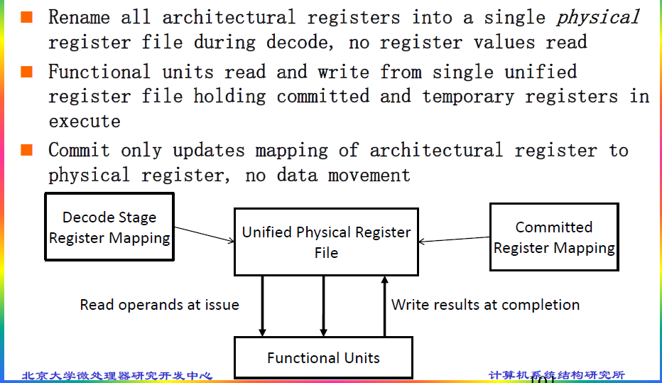
Unified Physical Register File

Slide 9
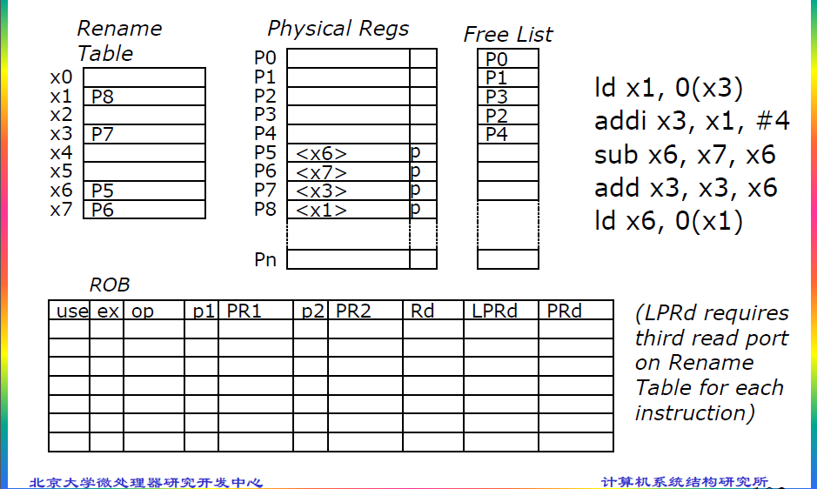
Unified Physical Register File

Slide 10
主要内容
Introduction & Overview
Instruction Fetch
Unified Physical Register File
The Decode Stage
The Rename Stage
ROB & The Dispatch Stage
The Issue Unit
The Register File and Bypass
The Execute Pipeline
The Load/Store Unit
后期工作安排

Slide 11
The Decode Stage
The decode stage takes instructions from the fetch buffer, decodes them, and allocates the necessary resources as required by each instruction. The decode stage will stall as needed if not all resources are available.

Slide 12
主要内容
Introduction & Overview
Instruction Fetch
Unified Physical Register File
The Decode Stage
The Rename Stage
ROB & The Dispatch Stage
The Issue Unit
The Register File and Bypass
The Execute Pipeline
The Load/Store Unit
后期工作安排

Slide 13
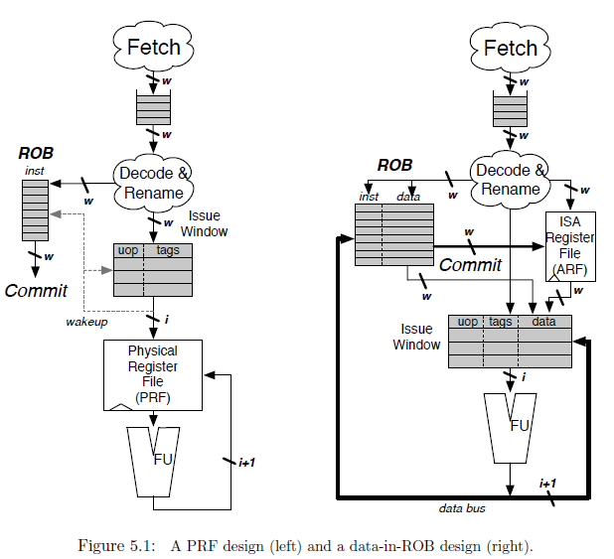
The Rename Stage
WAW & WAR
Explicit & Implicit
Committed & Speculative
Branch
Exception
Notes:
register renaming eliminates write-after-write (WAW) and write-after-read (WAR) hazards, which are artifacts introduced by a) only having a limited number of ISA registers to use as specifiers and b) loops, which by their very nature will use the same register specifiers on every loop iteration.
As instructions are renamed, their register specifiers are explicitly updated to point to physical registers located in the physical register file
A physical register file, containing many more registers than the ISA dictates, holds both the committed architectural register state and speculative register state.
This is in contrast to an "implicit renaming" or "data-in-ROB" out-of-order core design. The Architectural Register File only holds the committed register state, while the ROB holds the speculative write-back data
Each branch gets its own copy of the rename map table. On a branch mispredict, the map table can be reset from the mispredic branch's copy of the map table.
Exception： 两种策略（一步到位、回滚）

Slide 14
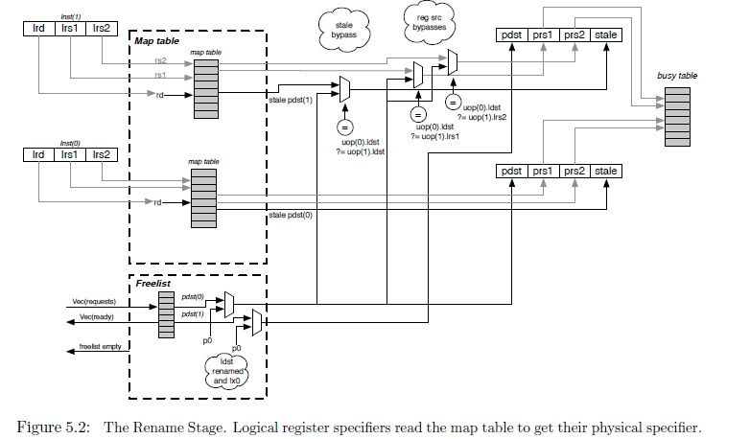
The Rename Stage
Notes:
1. The Busy Table tracks the readiness status of each physical register. If all physical operands are ready, the instruction will be ready to be issued.
2. The Free List is implemented as a bit-vector. A priority decoder can then be used to find the first free register. BOOM uses a cascading priority decoder to allocate multiple registers per cycle
3. Free List support for Branch：the Free List also sets aside a new "Allocation List", initialized to zero. As new physical registers are allocated, the Allocation List for each branch is updated to track all of the physical registers that have been allocated after the branch. If a misspeculation occurs, its Allocation List is added back to the Free List by OR'ing the branch's Allocation List with the Free List

Slide 15
主要内容
Introduction & Overview
Instruction Fetch
Unified Physical Register File
The Decode Stage
The Rename Stage
ROB & The Dispatch Stage
The Issue Unit
The Register File and Bypass
The Execute Pipeline
The Load/Store Unit
后期工作安排

Slide 16
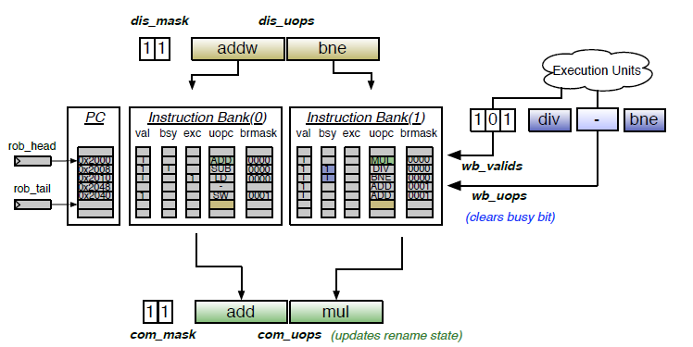
ROB & The Dispatch Stage
ROB Organization
circular buffer、w banks
valid/busy/exception/branch mask/uopc/lrd/stale pdst
floating-point status updates/other miscellaneous data
Figure 6.1: The Reorder Buffer for a two-wide BOOM with three-issue
Notes:
1. 跟踪流水线上所有指令、按序执行的假象
2. Dispatch：ROB & Issue Window、marked busy，如果指令Completed就会被标记为not busy
3. 若位于ROB head的指令发生Exception，ROB可以选择回滚的方式回退机器状态（table mapping 和 free list），整个流水线会被flush
4. W 是同时Dispatch或提交的指令数目
5. 每次被dispatch的指令必须是地址连续的，并且是对齐的，这样子多个bank能共享PC的高位域，PC的低位域用来索引Bank。所以，branch指令可能带来Bubble
6. other miscellaneous（五花八门） data (e.g., helpful for statistic（统计的） tracking)
7. 当store指令被提交时，该指令被发送到memory，对于多个stores同时被提交，LSU会被告知有多少个stores被提交，LSU将会依次提交stores到memory。

Slide 17
主要内容
Introduction & Overview
Instruction Fetch
Unified Physical Register File
The Decode Stage
The Rename Stage
ROB & The Dispatch Stage
The Issue Unit
The Register File and Bypass
The Execute Pipeline
The Load/Store Unit
后期工作安排

Slide 18
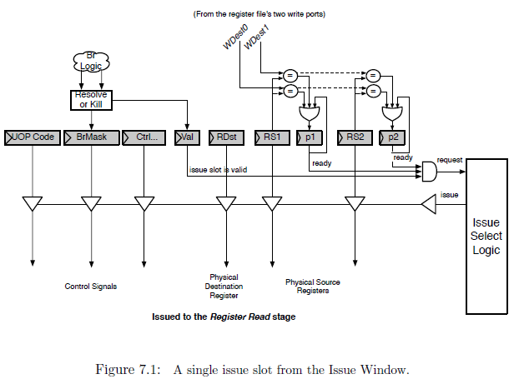
The Issue Unit
Issue window
Issue slot
Notes:
Issue window中保存还没有执行的微指令，微指令的操作数准备好，并且没有因为转移预测错误被取消时，会把request信号置为高，选择逻辑会在request信号有效的指令中选择进行发射
所有类型的指令共用一个发射窗口 发射逻辑有多个端口，每个端口处理一类微指令，选择逻辑实际上是一系列固定的优先级
功能单元无法使用时发射逻辑会取消掉request信号，等待wake-up重新开始发射指令
wake-up分为两种，fast wake-up和slow wake-up

Slide 19
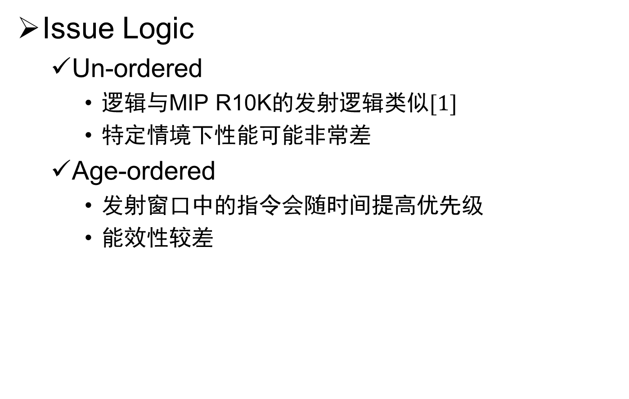
The Issue Unit
Issue Logic
Un-ordered
逻辑与MIP R10K的发射逻辑类似$[1]$
特定情境下性能可能非常差
Age-ordered
发射窗口中的指令会随时间提高优先级
能效性较差
[1] K. Yeager. The MIPS R10000 Superscalar Microprocessor. IEEE Micro, 16(2):28-41, 1996.
Notes:
Unordered：无法预测的分支指令会放在低优先级的位置上，直到ROB被填满，发射窗口开始收缩前，这个分支指令不会被发射

Slide 20
主要内容
Introduction & Overview
Instruction Fetch
Unified Physical Register File
The Decode Stage
The Rename Stage
ROB & The Dispatch Stage
The Issue Unit
The Register File and Bypass
The Execute Pipeline
The Load/Store Unit
后期工作安排

Slide 21
The Register File and Bypass
BOOM使用统一的物理寄存器堆
同时包含整数寄存器和浮点寄存器
用映射表实现寄存器重命名
读写口数量
能满足所有发射的指令
读写口与发射逻辑的端口对应关系固定
Bypass在Register Read阶段最后发生
REG
ALU
Issue
Logic
FPU
Notes:
BOOM使用了Berkeley hardfloat floating point units，硬件浮点单元内部使用65位操作数，因此所有的寄存器都是65位
假设

Slide 22
主要内容
Introduction & Overview
Instruction Fetch
Unified Physical Register File
The Decode Stage
The Rename Stage
ROB & The Dispatch Stage
The Issue Unit
The Register File and Bypass
The Execute Pipeline
The Load/Store Unit
后期工作安排

Slide 23
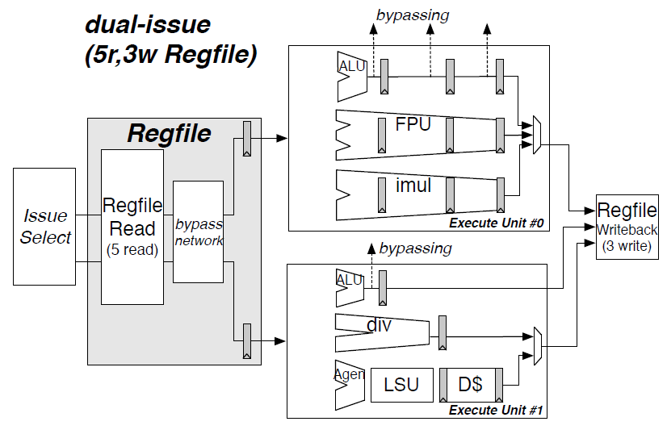
The Execute Pipeline
Execution Pipeline
Notes:
执行流水线包括了微指令的执行与写回
例子，一条双发射的执行流水线，包括两个执行单元，每个执行单元与一个发射端口对应，但内部可能有多个功能单元（Functional Unit）

Slide 24
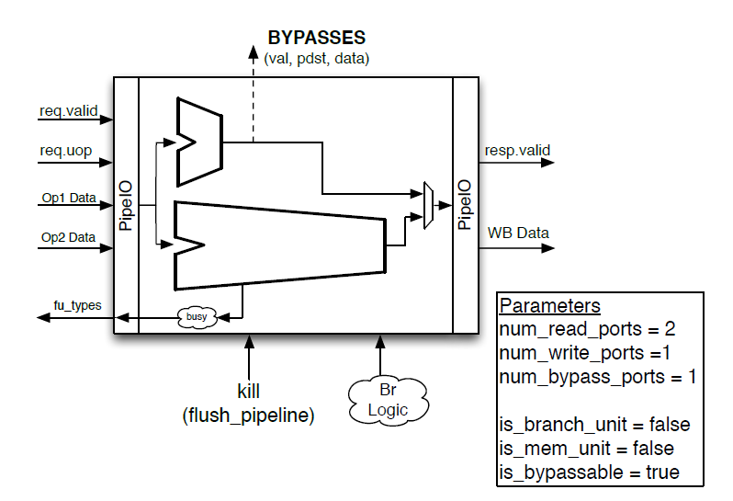
The Execute Pipeline
Execution Unit
Notes:
这个执行单元包含了一个整数ALU，他可以向相关的指令前递数据；还包括一个非流水线的除法器，除法运算时会将busy置为有效
需要接受kill信号和转移结果信号
Execution unit向issue window提供内部功能部件的空闲情况

Slide 25
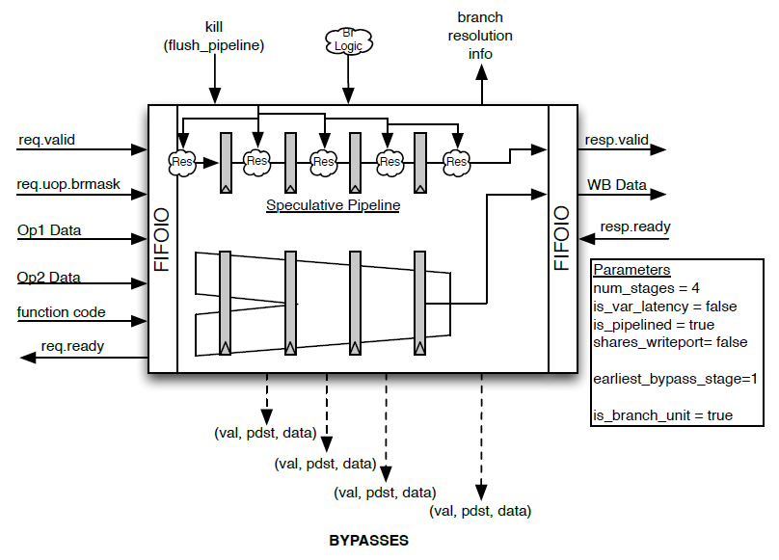
The Execute Pipeline
Functional Unit
Notes:
功能部件需要某个领域的专家来正确地实现与优化。BOOM用Functional Unit来包装这些功能单元（low level functional units）。
除去数据输入输出这些基本端口之外，BOOM中的功能部件需要能够响应kill信号，这里的做法是在数据退离低层功能部件时，把resp信号关掉

Slide 26
The Execute Pipeline
Branch Unit & Branch Speculation
所有的转移指令在译码阶段获得一个branch tag
所有的未提交指令维护一个branch mask，与branch tag对应，表明自己对应哪一个预测分支
预测正确，branch unit广播branch tag，所有对应的微指令清除自己的branch mask
预测错误，kill所有的对应微指令，修改PC，清除前端和fetch buffer
目前BOOM只支持一个branch unit

Slide 27
主要内容
Introduction & Overview
Instruction Fetch
Unified Physical Register File
The Decode Stage
The Rename Stage
ROB & The Dispatch Stage
The Issue Unit
The Register File and Bypass
The Execute Pipeline
The Load/Store Unit
后期工作安排

Slide 28
The Load/Store Unit
三个队列
Load Address Queue (LAQ), Store Address Queue (SAQ), Store Data Queue (SDQ)
Load指令产生uopLD微指令，计算地址并存入LAQ
Store指令产生两个微指令，uopSTA计算地址存入SAQ，uopSTD把数据存入SDQ，两个微指令可能不同时发射
Memory Model
Write-Read constraint is relaxed (newer loads may execute before older stores)
Read-Read constraint is currently relaxed (loads to the same address may be reordered)
A thread can read its own writes early
Notes:
Store指令在issue window中只占用一项以节省空间
存储地址经常比数据更早得出，地址应该尽快发往SAQ，以避免之后的load指令发生错误，所以地址和数据任何一方准备好时，issue window都会发射对应的微指令，另一半微指令保存在issue window中等到准备好再发射
对同一地址读指令序列的讨论与内存模型的描述有冲突之处。RISCV的内存模型希望加强对同一地址读序列的约束，后发生的读如果被提前执行了，需要取消并刷新流水线——但是这种场景只在发生了一致性的probe事件时才需要重排，如果没有probe发生可以不重排

Slide 29
The Load/Store Unit
Memory Ordering Failures
从性能方面考虑，load指令需要尽快发往内存
考虑以下场景
sw x1 → 0(x2)
ld x3 ← 0(x4)
x2与x4指向同一个内存地址，load比store更早发射到内存
为了发现这种错误，store指令发射到LSU时，需要检查整个LAQ中是否有匹配地址，如果有已经被执行，并且获得了数据的load，那么发生了memory ordering failure
需要清空流水线，重置重命名映射表

Slide 30
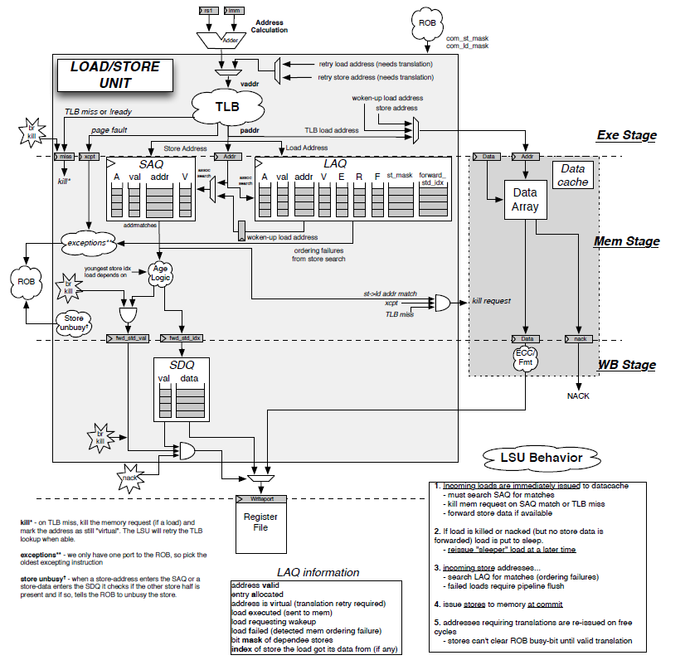
The Load/Store Unit

Slide 31
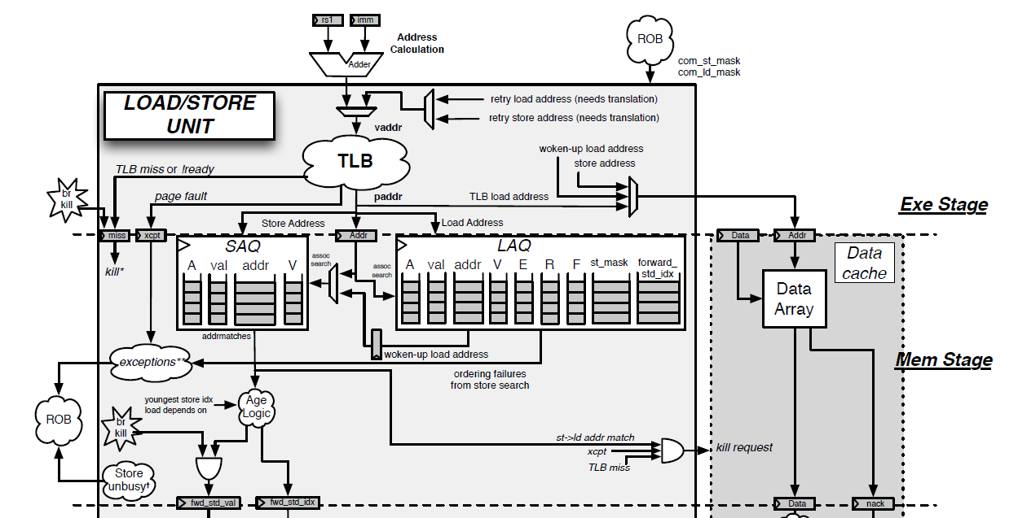
The Load/Store Unit
Notes:
A：是否已分配
val：地址是否有效
V：地址是虚拟地址还是物理地址（是否需要重试地址翻译）
E：load是否已发往内存
R：load指令等待唤醒
F：load指令失败（发现了mem ordering failure）
st_mask：依赖的store指令
forward_std_idx：由哪条store指令前递数据
执行阶段访问TLB进行地址翻译，无论TLB是否命中，都将地址存入SAQ和LAQ中，如果TLB未命中，需要kill已经发往内存的load
Store unbusy：store的微指令如果在队列中发现了自己的另一半，告诉ROB把store设为unbusy

Slide 32
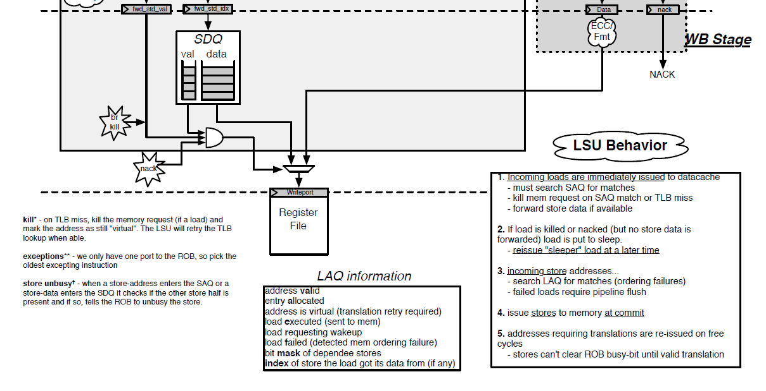
The Load/Store Unit

Slide 33
The Load/Store Unit
Data-cache Shim
BOOM使用了Rocket的cache，shim用于连接BOOM和cache
BOOM会向cache发送推测的load指令，shim需要跟踪所有正在执行的load，并取消推测错的指令
Hellacache不对store指令回复ack，nack不存在就认为成功
所有发往Hellacache的请求都可能在发射的下一周期被取消
目前设计的d-cache访问SRAM需要一个周期

Slide 34
Example : Branch
bne x1, x2, #4
p3,p4 is ready, so, when the branch unit is not busy, this branch can be issued.
x0
x1 | p3
x2 | p4
…
x31
p0
p1
p2 | 0x1 | p
p3 | 0x3 | p
p4 | 0x4 | p
…
pn
p0
p1
p9
…
x0
x1 | p3
x2 | p4
…
x31
copy
rename table
rename table copy
physical register file
free list
alloc list
 | v | b | e | bmask | uopc | lrd | stale
head
…
tail | 1 | 1 | 0 | 0000 | bne
PC file
ROB
issue window
Branch
Unit

Slide 35
主要内容
Introduction & Overview
Instruction Fetch
Unified Physical Register File
The Decode Stage
The Rename Stage
ROB & The Dispatch Stage
The Issue Unit
The Register File and Bypass
The Execute Pipeline
The Load/Store Unit
后期工作安排

Slide 36
后期工作安排
 | 任务 | 人数 | 文档章节 | 代码文件（.scala) | 代码行数
按序部分 | Instruction Fetch | 1 | 第二章（2页） | fetch | 253+
 | Branch Prediction | 2 | 第三章（14页） | brpredictor/bpd_pipeline/2bc-table/simplegshare/gshare/gskew/tage/Tage-csr/tage-table/tage-tagmemory/tage-ubits | 3461
 | Decode & Rename | 1 | 第四/五章（5页） | decode/fudecode/microop/rename | 1889
 | ROB & Dispatch | 1 | 第六章（4页） | rob | 1085
乱序部分 | Issue Unit | 1 | 第七章（3页） | issue/issue_slot/issue_ageordered/issue_unordered | 668
 | Register File & Bypass Network | 1 | 第八章（2页） | regfile/registerread | 304
 | Execute Pipeline | 2 | 第九章（8页） | execute/execution_units/functional_unit/imul | 1679
 | LSU & Dcache Shim | 2 | 第十章（5页） | lsu/dcacheshim | 1757

Slide 37
后期工作安排（探讨）
阅读文档和熟悉代码，了解Boom的整体架构，重点掌握各位负责的子模块的功能和对外连接情况
3/10-3/14：阅读文档，熟悉各模块
3/15-3/21：书写SPEC文档（基本功能、对外接口）
阅读文档和代码，探索各子模块的设计方案（4周）
书写详细设计文档（2周）

Slide 38
谢谢！

